Slide 1



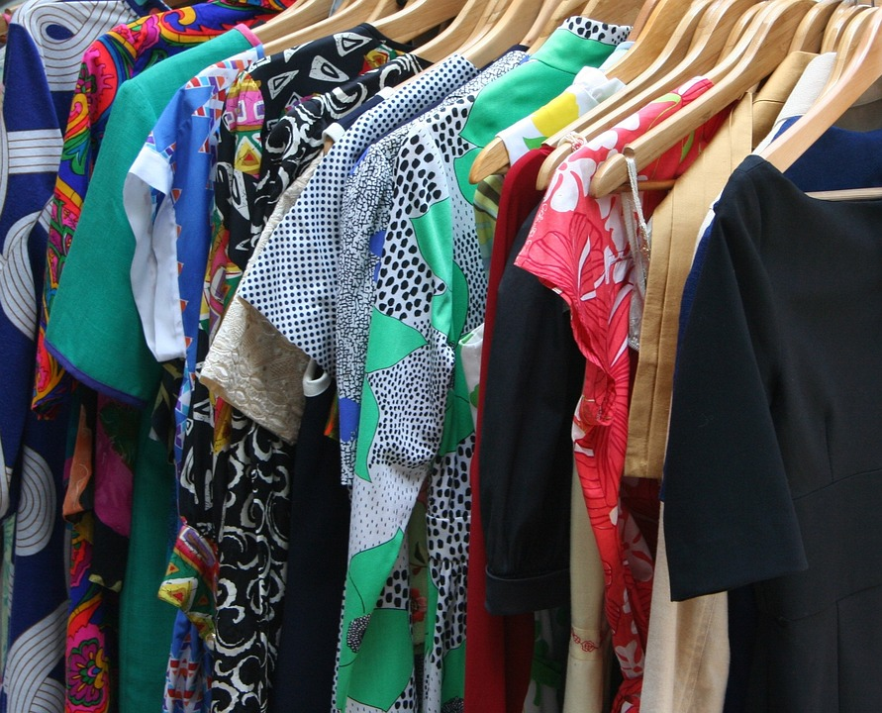
Group 4
Clothing Market Analysis and Price Prediction

Slide 2

Group Members
01
Trịnh Duy Phong
Pre-processing, EDA
02
03
Hoàng Trung Khải
UI, XGB, FCNN
Nguyễn Thành Minh
Crawling, Report , Pre-processing
04
05
Nguyễn Việt Anh
Crawling, MLP
Lưu Hoàng Phan
DT, RF, Slide

Slide 3
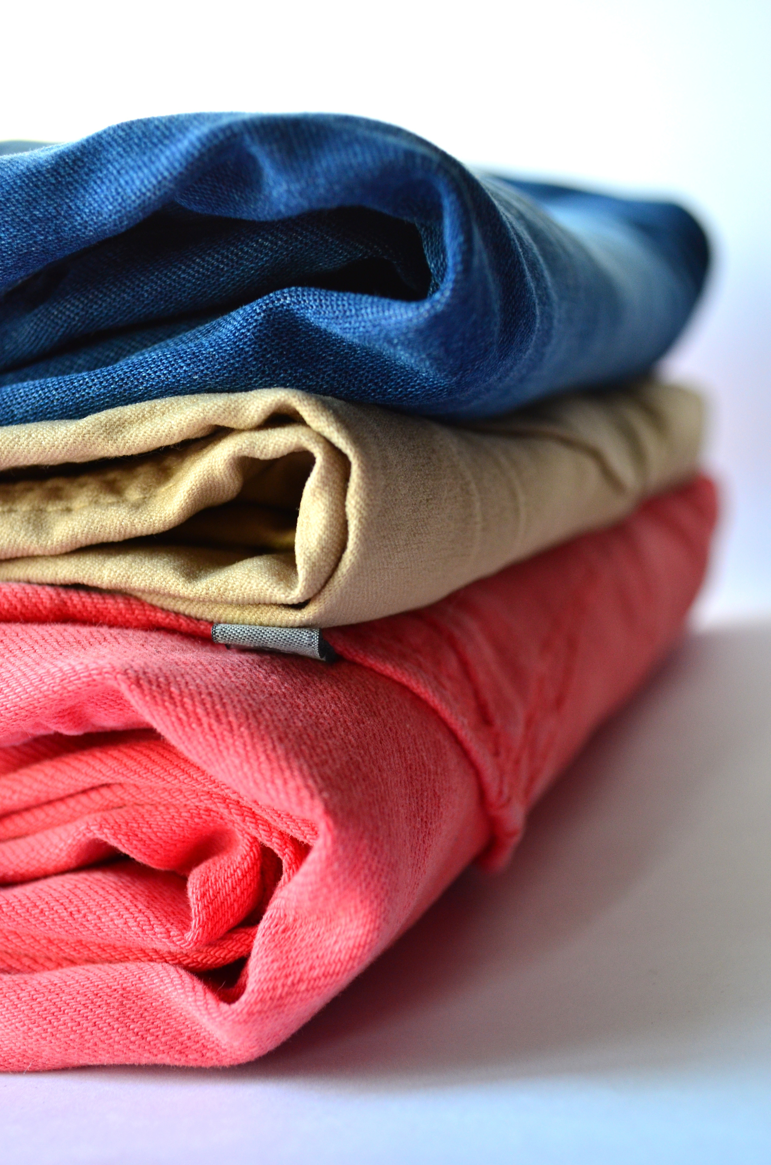
Introduction to Clothing Market
The clothing market is a dynamic, ever-evolving industry driven by fashion trends, seasonal changes, consumer preferences, and global influences.
Understanding these trends and price shifts is crucial

Slide 4
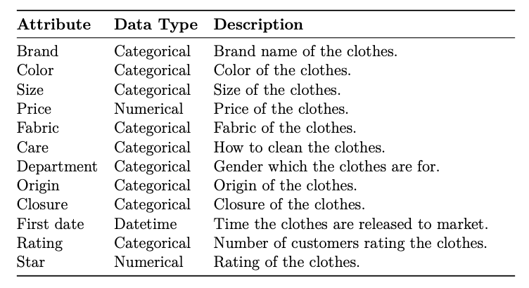
Data Acquisition

Slide 5
Database Constructing
Colours
Black, Blue, Green, White, Navy, etc ….
Brand
Prettgarden , Under Armour , Dokotoo, Amazon Essentials , Hanes, etc ……
Material
Polyester ,Nylon , Cotton, Rayon , Spandex, etc …

Slide 6



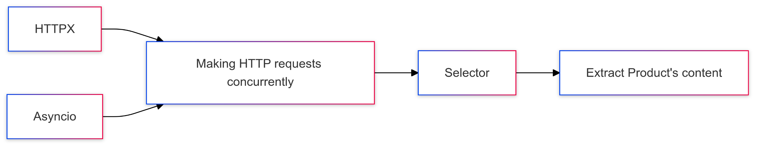
Technologies
Crawling
In this project, Amazon, one of the most popular e-commerce sites with various products, will be mined for information about clothes.
In order to scrape Amazon reliably at large scale, we use:
HTTPX and Asyncio to make HTTP requests concurrently
Selector to extract products’ content

Slide 7
Scraping Flow
1. Search: Search the clothes according to categories (dress, shirt,...)
2. Extract ASIN: Extract ASIN from the links of products
3. Variants: Fetch all variants’ ASIN of a product
4. Filter data: Only keep variants with color and size in the list of colors and sizes(further elaboration on Data Preprocessing section) or partly resemble to the list
5. Scrape attributes: Scrape all attributes of a product (list of attributes are on At-tributes Scraped section)

Slide 8
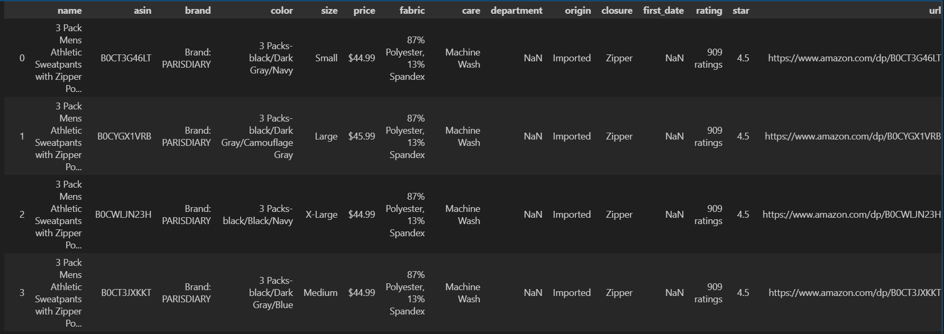
Data Pre-processing
Figure 1 : Raw data
Data preprocessing is an essential step in preparing the dataset for model development . In this section, we detail the steps taken to clean the data, handle missing values, and standardize categorical attributes. After preprocessing we have 19080 data.

Slide 9
Data Pre-processing
Handling Missing Values in the Color Column
Missing values imputed by maintaining the distribution of existing color data using probability-based assignment.
Categorical Data Encoding
Transformed categorical string attributes into numerical values for compatibility with machine learning models.
Removing the First Date Column
Removed due to lack of variability and relevance for price prediction, reducing noise and enhancing focus.
Standardizing Colors and Sizes
Unified inconsistent entries:
Colors: Standardized to 12 categories (e.g., "black," "white," "red").
Sizes: Standardized to 5 categories (e.g., "small," "medium," "large").

Slide 10
Data Pre-processing
Encoding Techniques:
Color: Assigned a unique numeric label to represent each of the 12 colors in the dataset. For example, 0 corresponds to 'Black,' 1 to 'Blue,' 2 to 'Brown,' 3 to 'Green,' and 4 to 'Grey,' continuing similarly for the other colors
Size: Label encoding to reflect ranking:
"small" → 0.0
"medium" → 1.0
"large" → 2.0
"x-large" → 3.0
"xx-large" → 4.0
Fabric: Processed for multi-fabric compositions, standardized to 12 main types (e.g., "Polyester," "Cotton")
Care and Closure: each features is one column , the value is 1 if the product has the feature , 0 if the feature is not in the product information

Slide 11

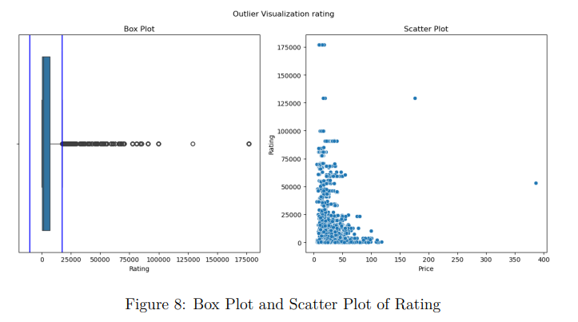
Exploratory Data Analysis

Slide 12
Detect Outlier
The green vertical lines in the box plots represent the IQR lines.
In conclusion, we eliminate rows with rating > 75000 and star < 3.5 based on these assumptions

Slide 13
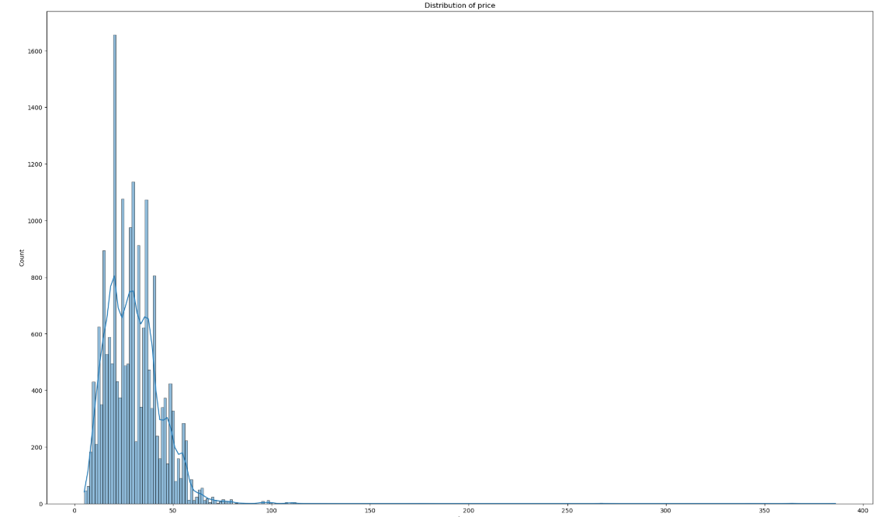
Exploratory Data Analysis
The above figures show that the most common price range lies between approximately 0--50 dollars. The lowest-priced item in the dataset starts at just a few dollars, while a few premium items extend well beyond 200 dollars.

Slide 14
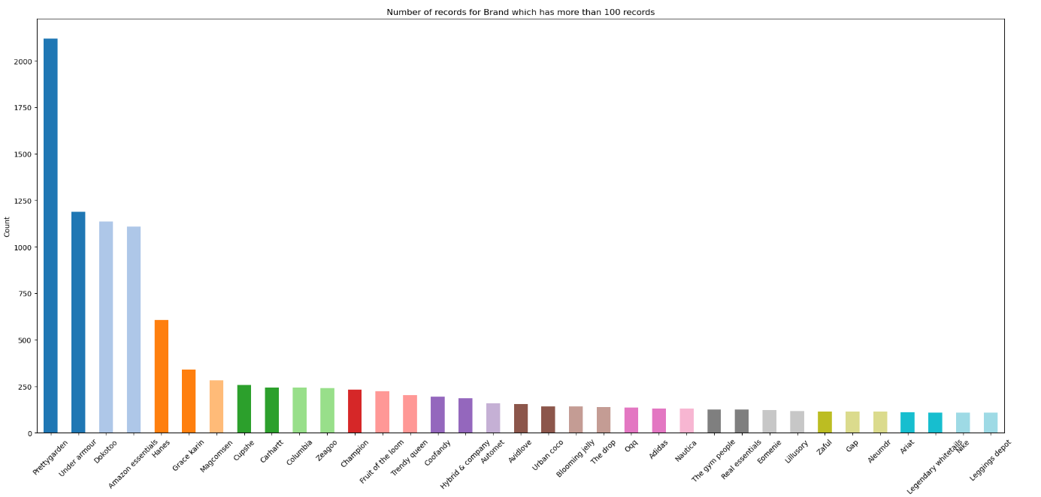
Exploratory Data Analysis
The chart highlights that ”Prettgarden” has the highest number of records, over 2000, followed by ”Under Armour”, ”Dokotoo” , and ”Amazon Essentials” , each with over 1000 records. The remaining brands have significantly fewer records, many of them under 500

Slide 15
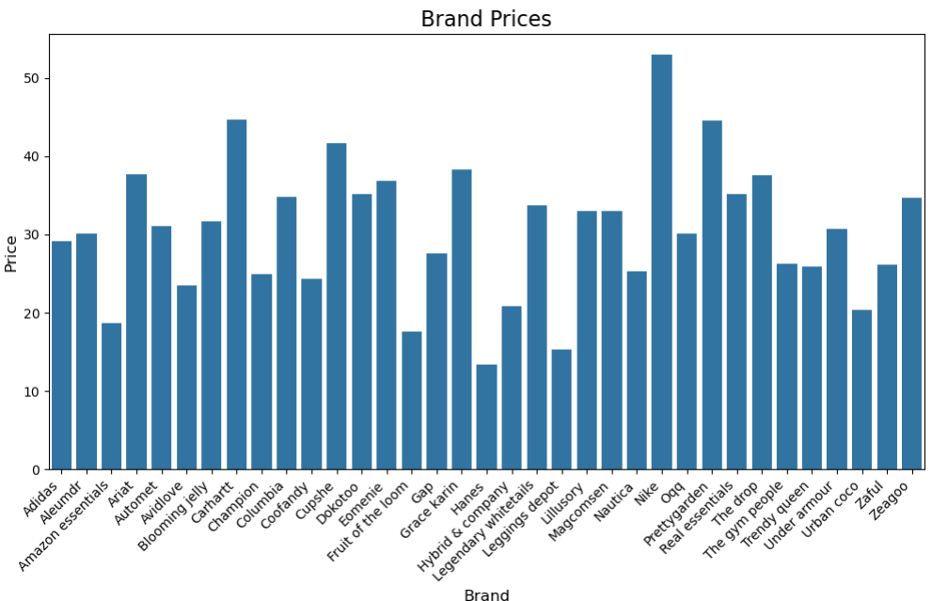
Exploratory Data Analysis
The bar chart illustrates the prices of various brands, highlighting a diverse range of price points. Most prices fall between $10 and $50, with one brand reaching the highest price point while others cluster around the lower end. A significant portion of the brands have mid-range pricing, indicating competitive strategies among them.

Slide 16
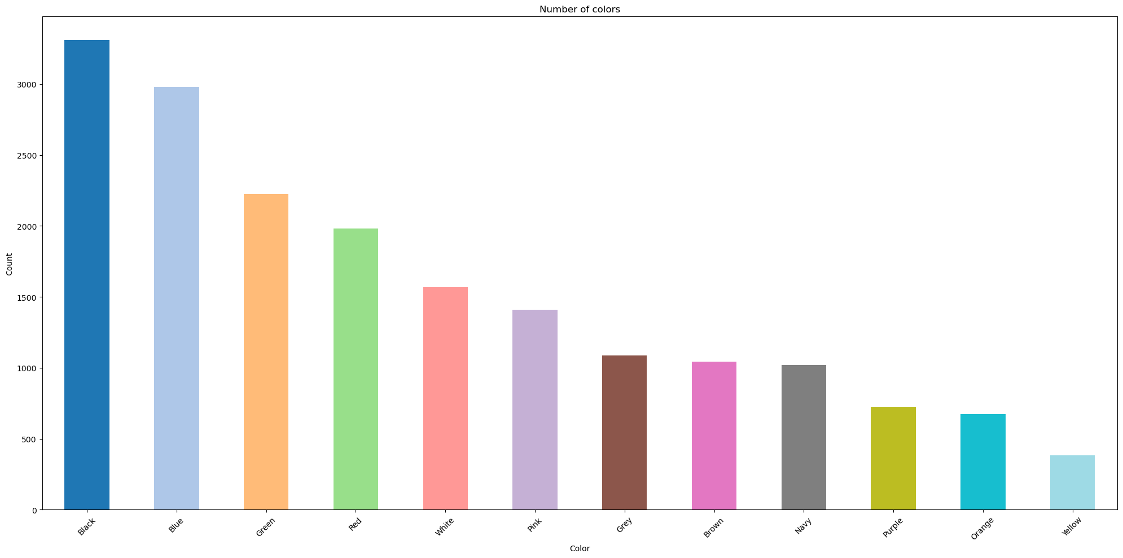
Exploratory Data Analysis
Black is the most popular color, with over 3500 entries, followed by Blue, while colors like Yellow and Orange are much less common, with fewer than 1000 entries each.

Slide 17
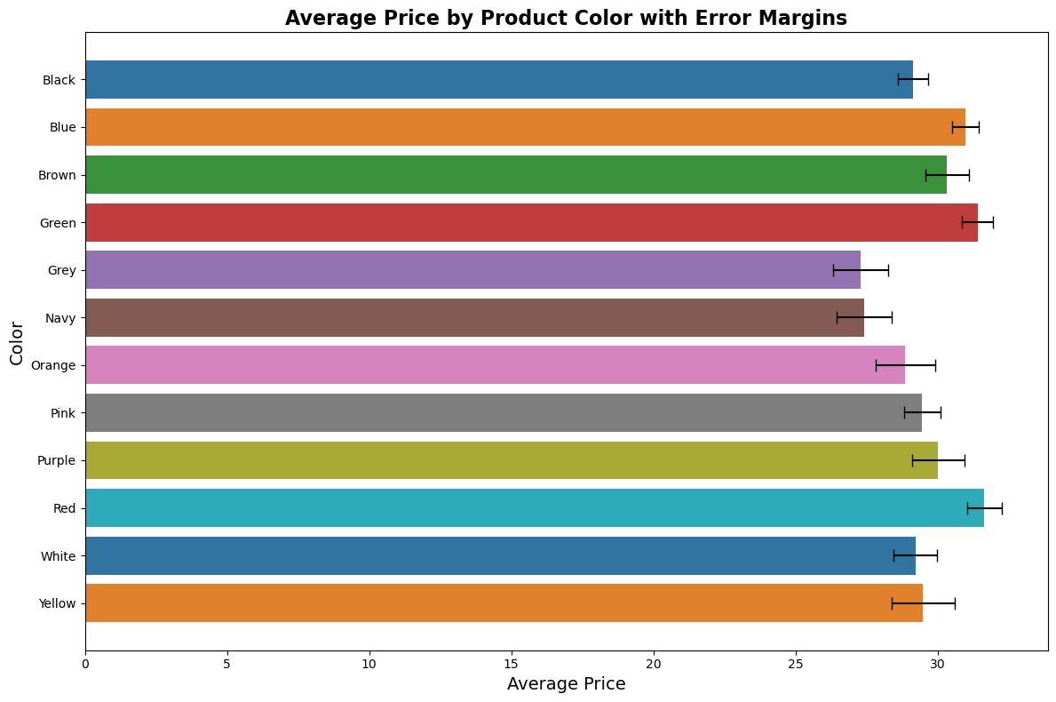
Exploratory Data Analysis
The average price of products for each color, with error bars representing the variation in prices within each group. The average prices are fairly consistent across colors , falling between 25 and 30 dollars.

Slide 18
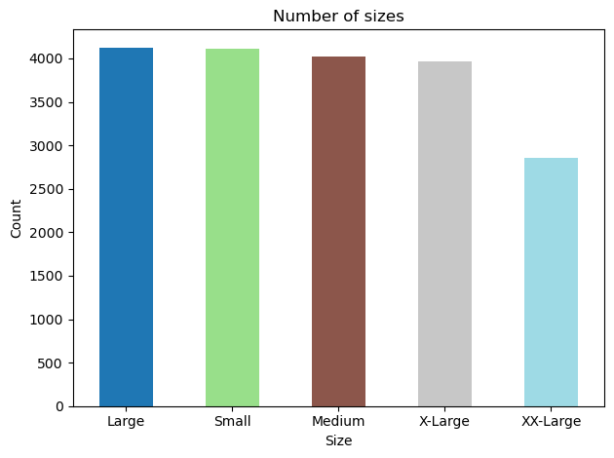
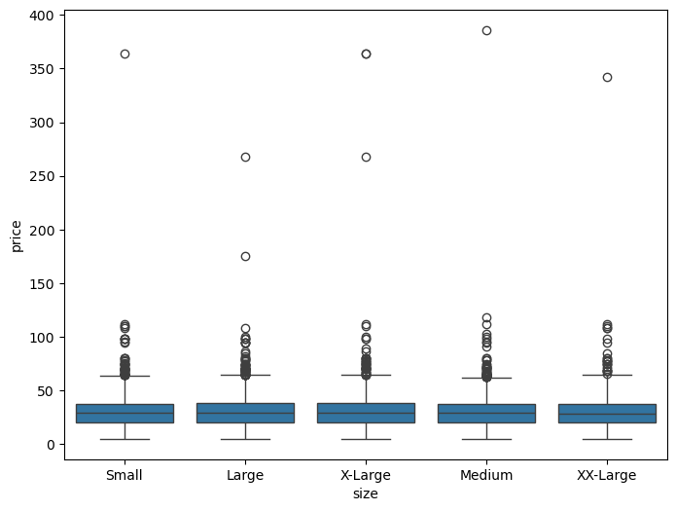
Exploratory Data Analysis
- Large, Small, and Medium sizes dominate the dataset, each accounting for over 4000 products
- The price distribution exhibits a consistent pattern, with most items falling below 50 dollars, as shown by the uniform medians. The interquartile ranges are similar, indicating that size has little effect on price variation.

Slide 19
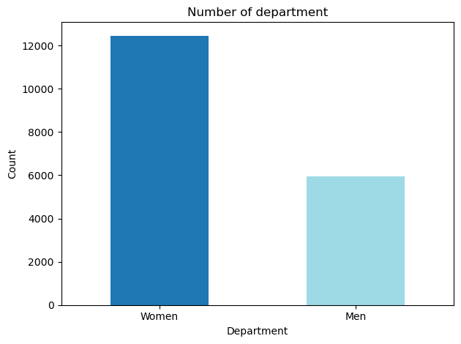
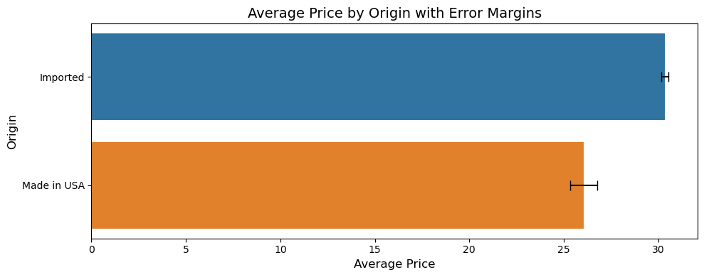
Exploratory Data Analysis
- The bar chart depicts the number of individuals in two categories, Women and Men, across a department. It shows that the Women category significantly outnumbers the Men category, with Women surpassing 12,000, while Men are slightly over 6,000.
- The "Imported" category shows a slightly higher average price compared to "Made in USA." Both bars are accompanied by error margins, represented as horizontal lines, indicating variability or uncertainty in the data.

Slide 20
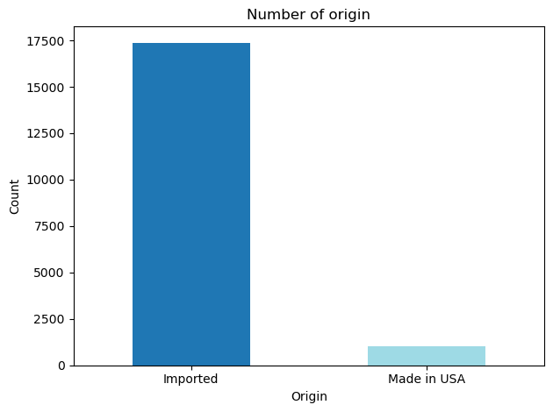
Exploratory Data Analysis
The vast majority is Imported, accounting for over 17,500 entries. This imbalance suggests a strong reliance on imported goods in the dataset.

Slide 21
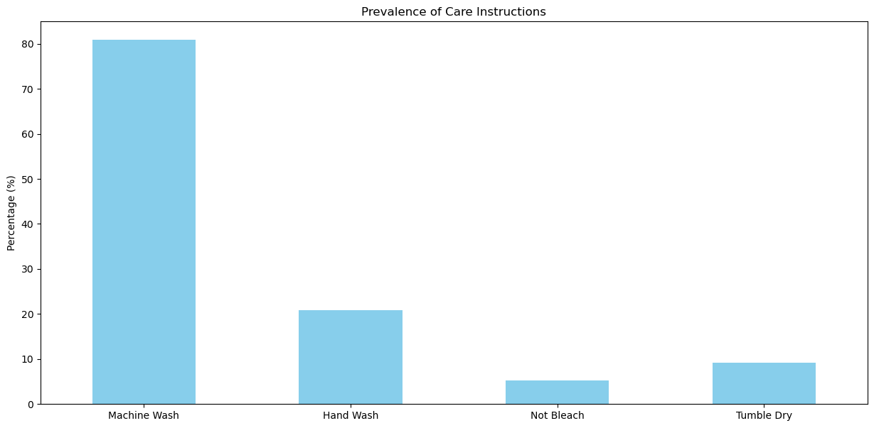
Exploratory Data Analysis
The bar chart illustrates the prevalence of various care instructions, expressed as percentages. "Machine Wash" dominates, accounting for approximately 80% of the total, indicating its widespread preference or recommendation.

Slide 22
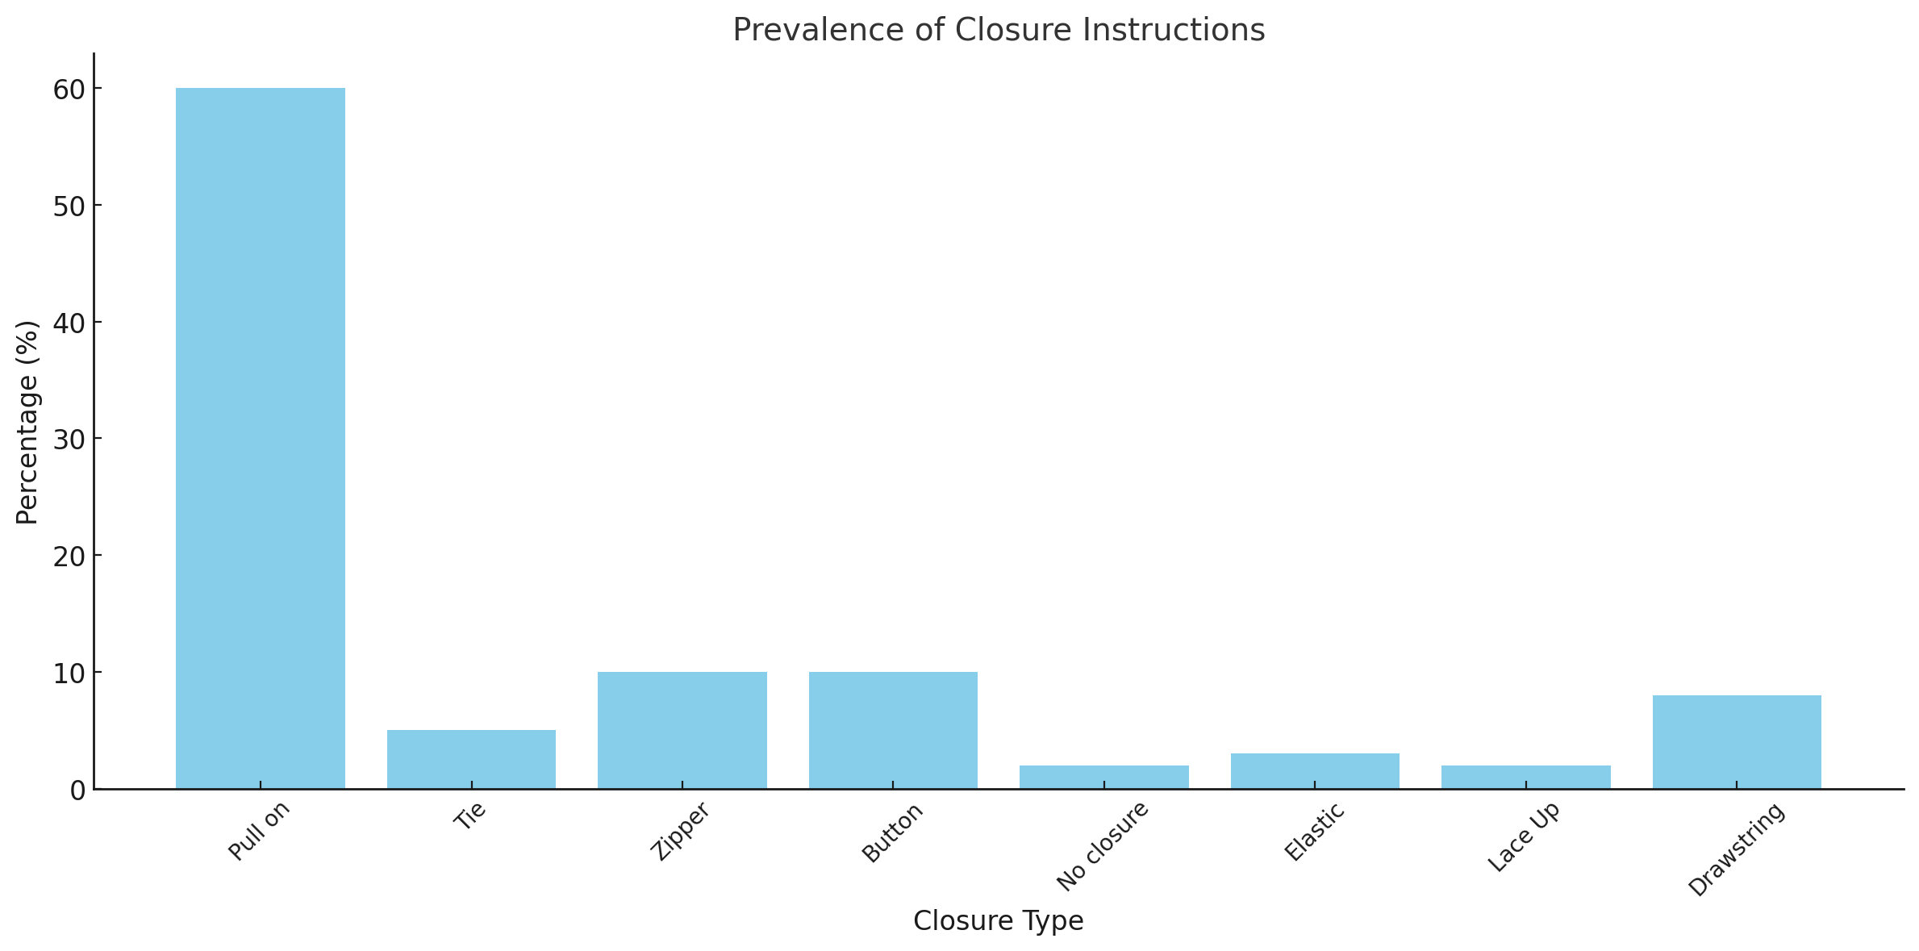
Exploratory Data Analysis
”Pull on” is the dominant closure type, representing nearly 60% of the total, indicating its popularity for ease of use and simplicity. Other closures, such as ”Zipper” and ”Button,” are moderately represented, each accounting for around 10% of the garments

Slide 23
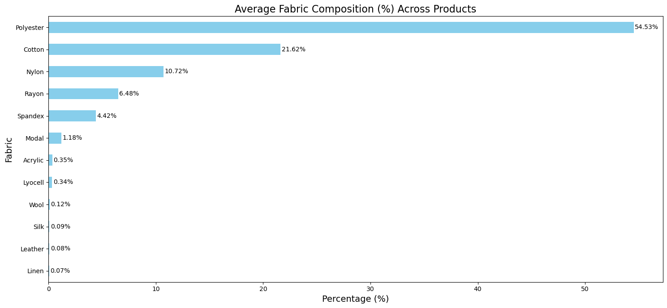
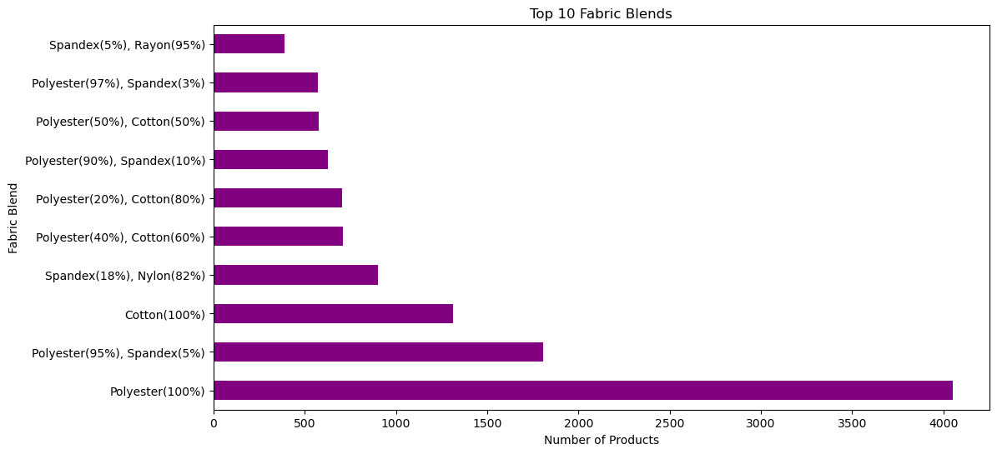
Exploratory Data Analysis
Polyester stands out as the most common fabric, with over 10,000 products, exceeding the frequency of other materials.
Among the top 10 fabric blends, Polyester (100%) stands out as the most common , with over 4,000 products, followed by Polyester (95%) and Spandex (5%).

Slide 24
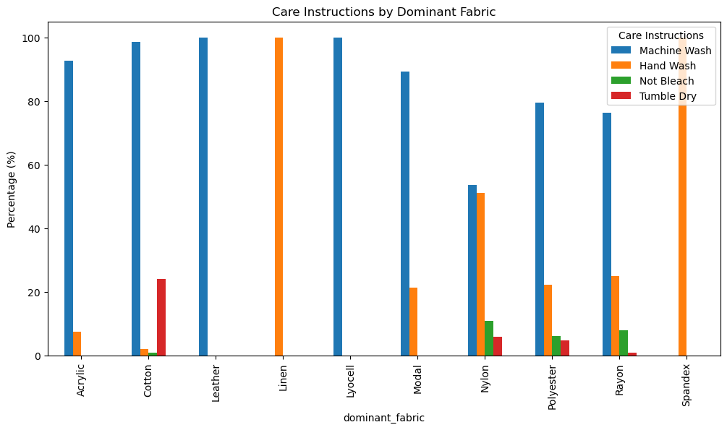
Exploratory Data Analysis
This bar chart illustrates the percentage distribution of care instructions for various dominant fabric types, including Acrylic, Cotton, Leather, Linen, Modal, Nylon, Polyester, Rayon, and Spandex. The care instructions are categorized into Machine Wash, Hand Wash, Do Not Bleach, and Tumble Dry.

Slide 25
Models : Decision Tree
Decision Tree is a supervised machine learning algorithm. It works by splitting the
dataset into subsets based on the feature that best separates the data at each node.
The tree structure consists of internal nodes representing feature tests and leaf nodes
representing the final prediction.

Slide 26
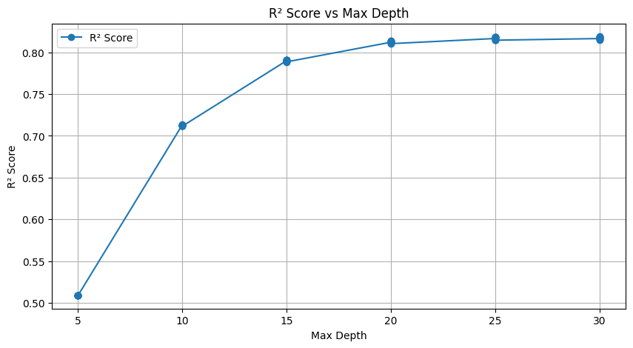
Models : Decision Tree
The analysis revealed that R2 scores improve gradually and start to become more inconsistent from depth 20 .

Slide 27
Models : Random Forest
Random Forest is an ensemble learning algorithm that builds multiple decision trees
and combines their predictions to improve accuracy and robustness. Each tree is trained
on a random subset of the data, using a technique known as bootstrapping, and at each
node, a random subset of features is considered for splitting. This randomization helps to
reduce overfitting and increases the model’s generalizability.

Slide 28
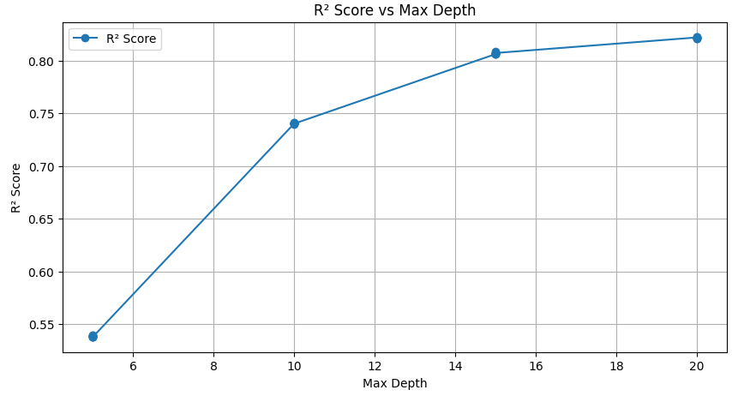
Models : Random Forest
The model’s performance metrics as max depth increases: the R-squared (R2) score steadily improves, reaching its peak at 20.

Slide 29
Models : XGBoost
XGBoost is an advanced implementation of gradient boosting, used for both classification and regression tasks. It builds multiple decision trees sequentially, where each tree attempts to correct the errors made by the previous ones. XGBoost includes regularization (L1 and L2) to prevent overfitting and improve model generalization.

Slide 30
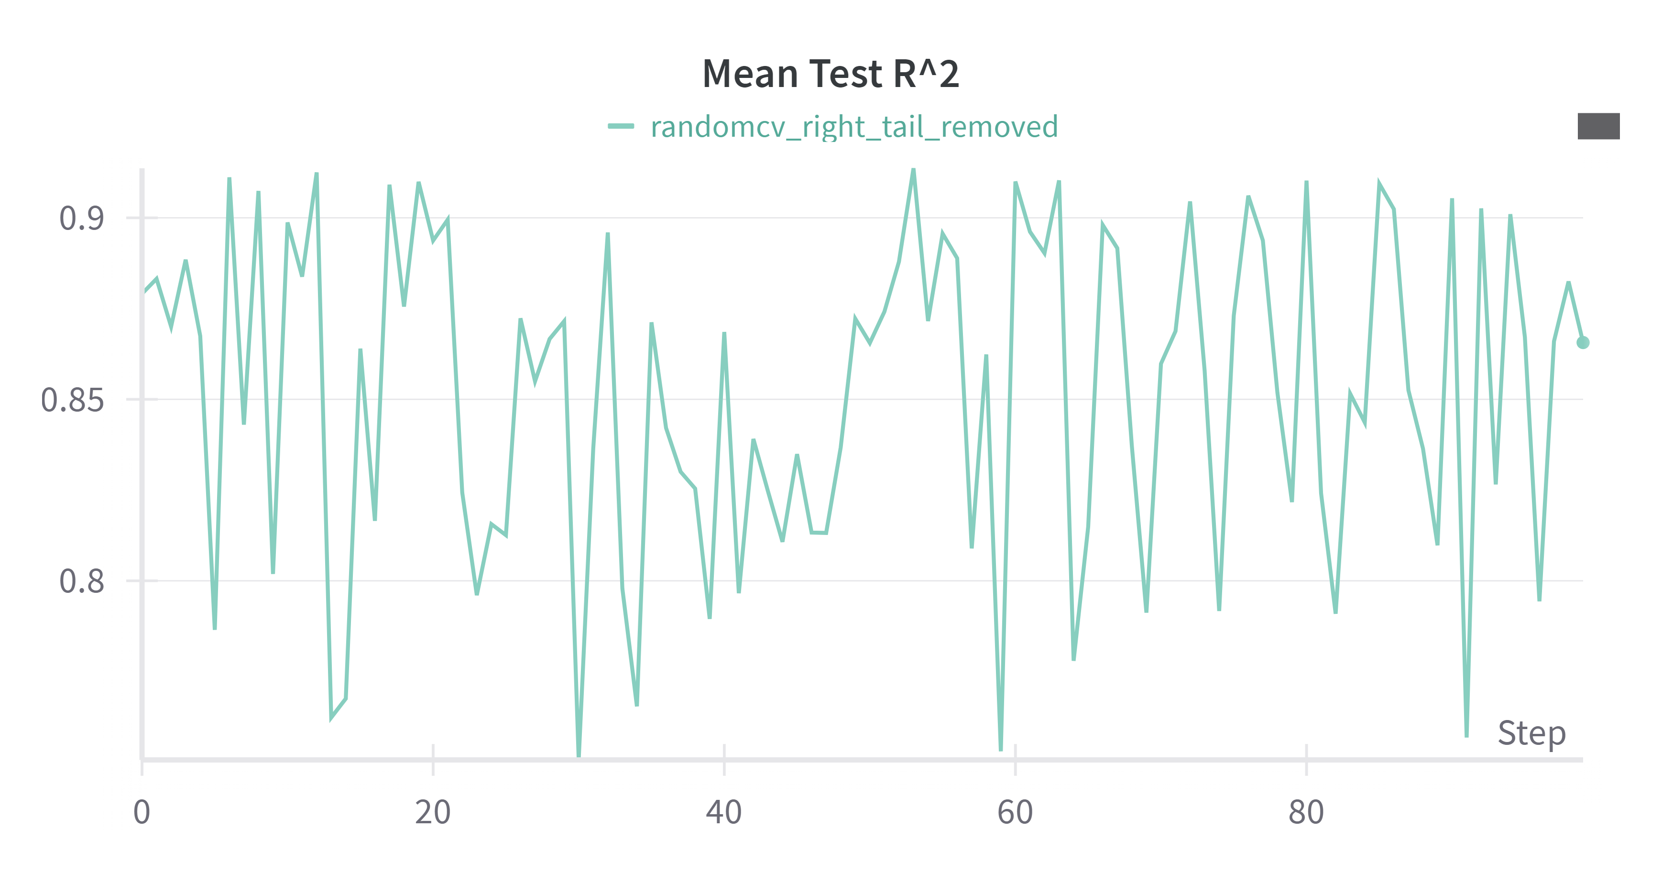
Models : XGBoost
There are fluctuations in the mean test R-squared scores across different steps of the
random search, with a general trend clustering between 0.85 and 0.9. This highlights
the model’s sensitivity to specific hyperparameter combinations and the importance of
fine-tuning.

Slide 31
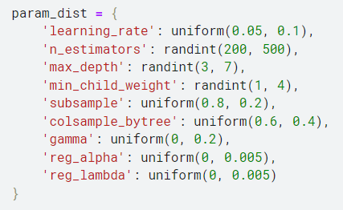
Models : XGBoost

Slide 32
Models : FCNNs
Fully Connected Neural Networks (FCNNs) are a fundamental type of artificial neural
network, consist of multiple layers of interconnected neurons, where each neuron in a layer
is connected to every neuron in the subsequent layer. FCNNs excel at capturing complex
relationships in data through their non-linear activation functions, making them highly
versatile.

Slide 33
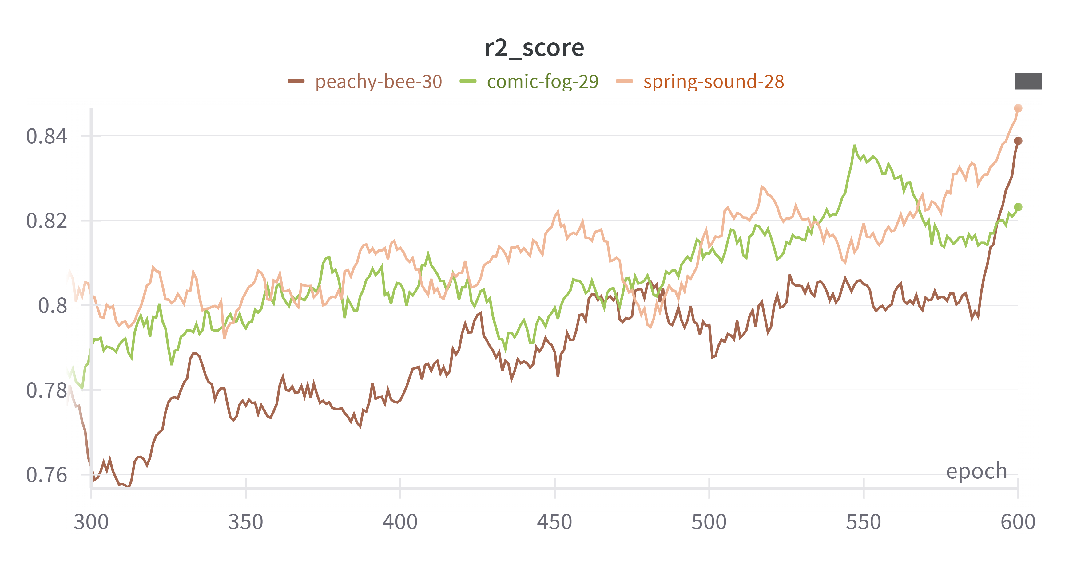
Models : FCNNs
The R-squared (R2) scores of the Fully Connected Neural Network (FCNNs) model
are tracked over 600 training epochs across three runs with different initialization seeds.
All runs exhibit a steady upward trend, with some variability in the early epochs that
stabilizes as training progresses. By the later stages, the R2 scores converge above 0.8,
demonstrating consistent performance improvement and robustness.

Slide 34
Models : MLPs
Multilayer Perceptrons (MLPs) are an artificial neural network commonly used for
both classification and regression tasks. They include multiple layers of fully connected
neurons, which allows them to capture complex, non-linear relationships in data through
activation functions like ReLU or Sigmoid.

Slide 35
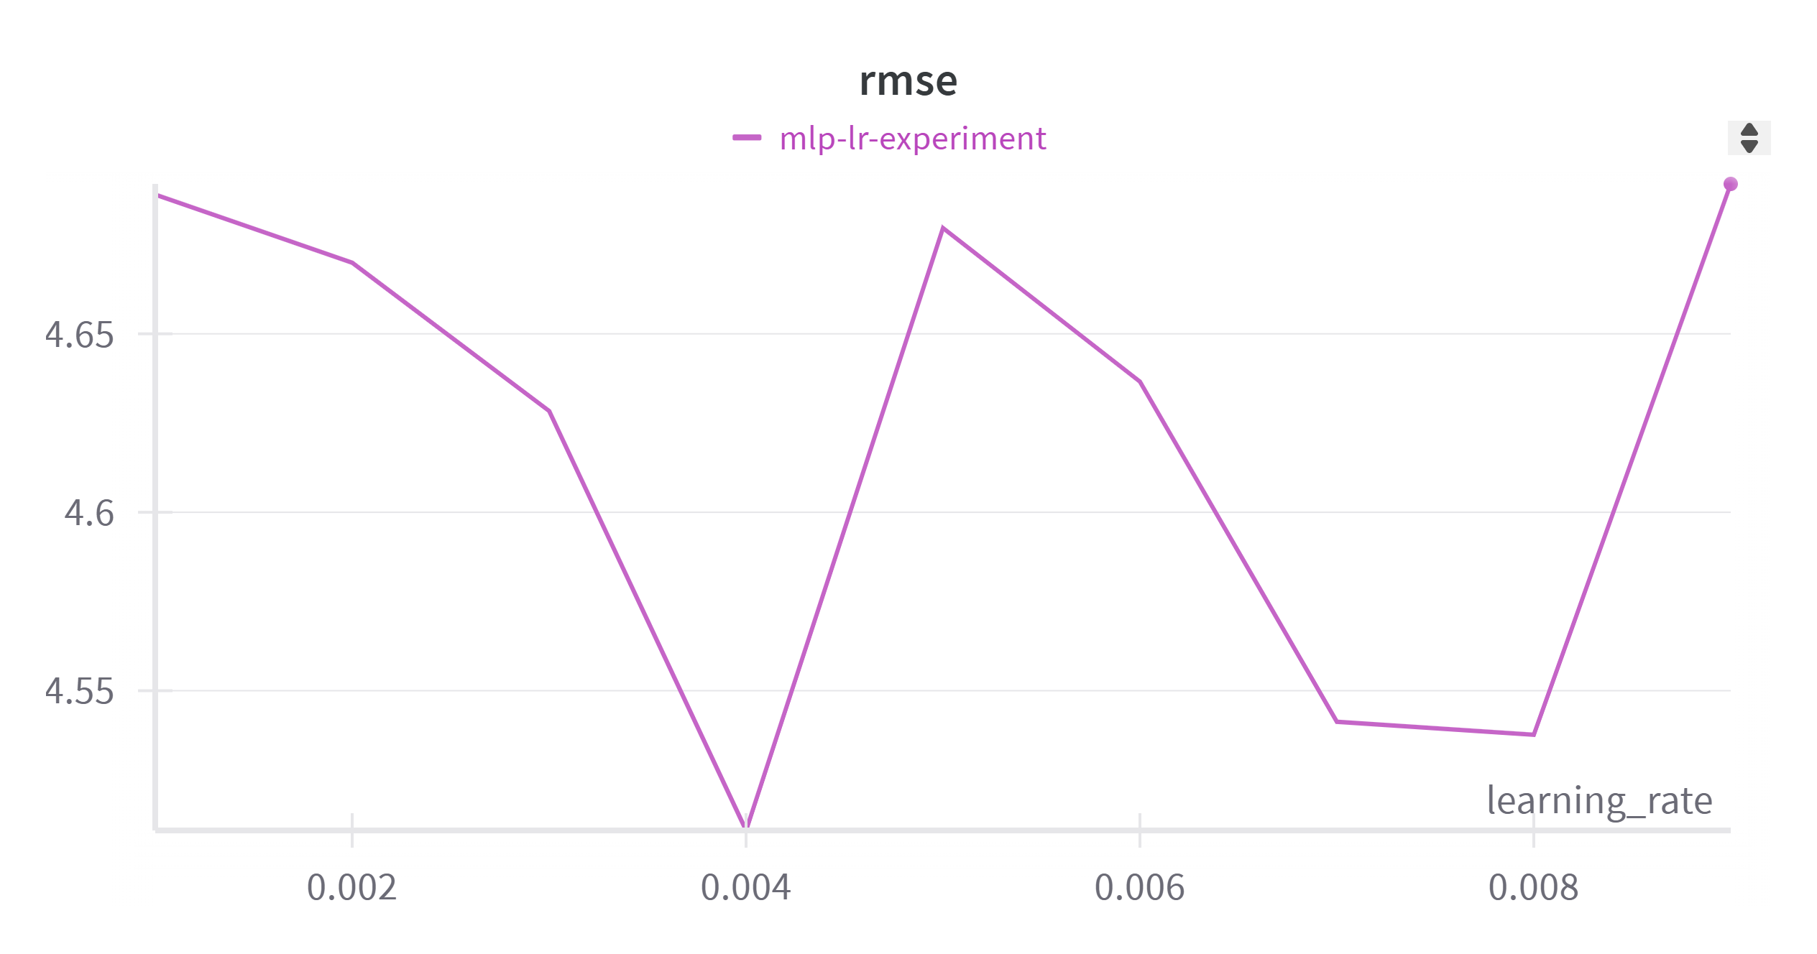
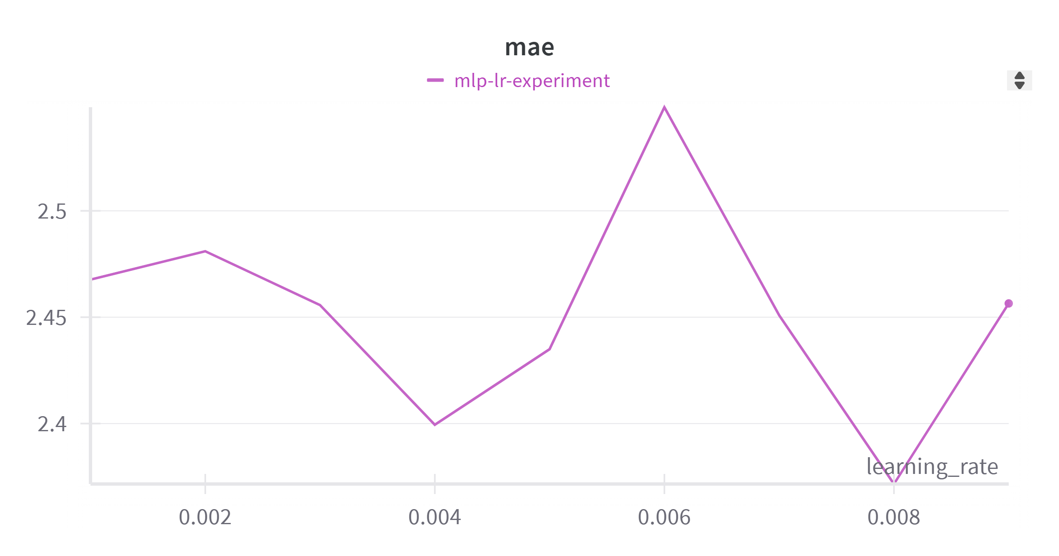
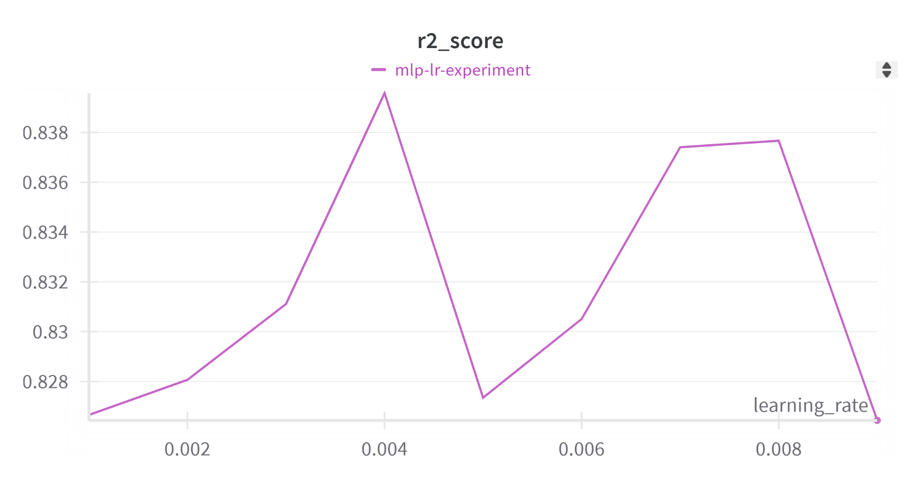
Models : MLPs

Slide 36
Models
No | Model | R2 Score | MAE Loss
1 | Decision Tree | 0.8077 | 9.2370
2 | Random Forest | 0.8100 | 0.0496
3 | XGBoost | 0.9109 | 1.6715
4 | FCNNs | 0.8516 | 2.5622
5 | MLPs | 0.8421 | 2.2612
Performance of applied models

Slide 37


Future works
In the future, we hope to expand the dataset by crawling additional time series data, especially focusing on diverse patterns, lengths, and complexities. This includes exploring datasets from financial, weather, or sensor-based domains to apply model performance into real-world applications.
Ethical Use of Data
Conclusion
XGBoost stood out with the highest R2 score of 0.910 and the lowest root mean square error (RMSE) of 3.365, making it the most accurate model for this dataset.
Neural network models, such as FCNNs and MLPs, performed moderately well. However, their relatively higher computational cost compared to XGBoost suggests that while they show promise .

Slide 38
Conclusion
In the future, we hope to expand the dataset by crawling additional time series data, especially focusing on diverse patterns, lengths, and complexities. This includes exploring
datasets from financial, weather, or sensor-based domains to apply model performance into real-world applications.
Ethical Use of Data

Slide 39

Thank You

Slide 40
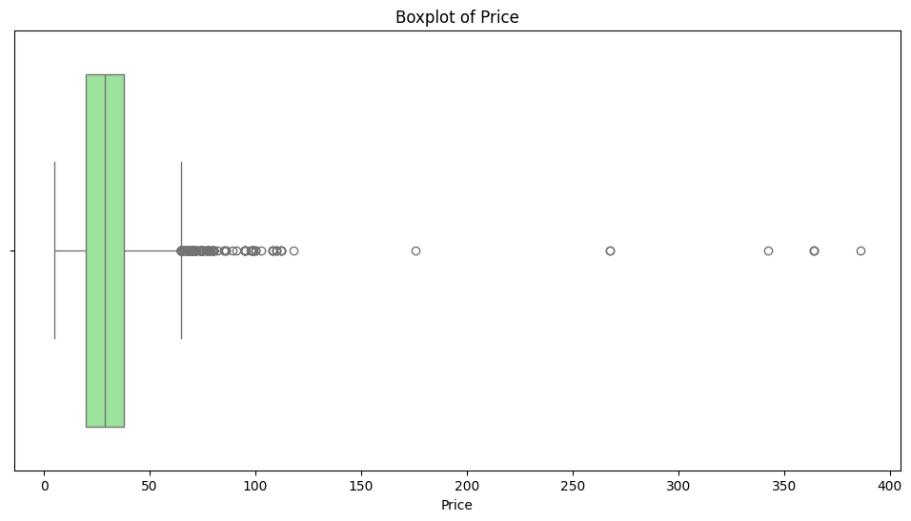

Slide 41
